Slide 1
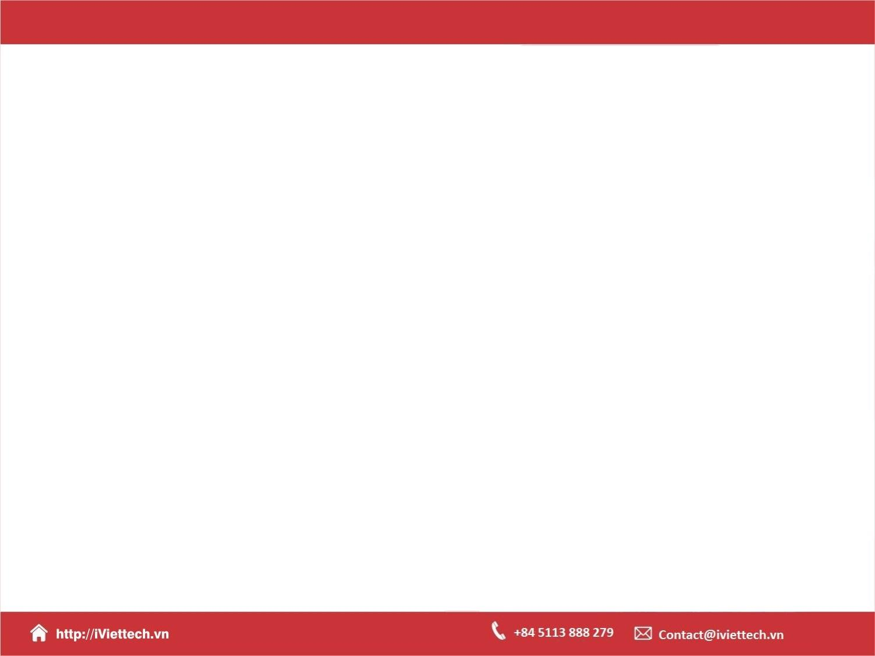
Chapter 1
Introduction to Django

Slide 2

Objectives
How the Model View Template (MVT) paradigm works and how Django processes HTTP requests and responses.
Learn about the manage.py command.
How to work with PyCharm.
How to use PyCharm's debugger to troubleshoot problems with your code.

Slide 3
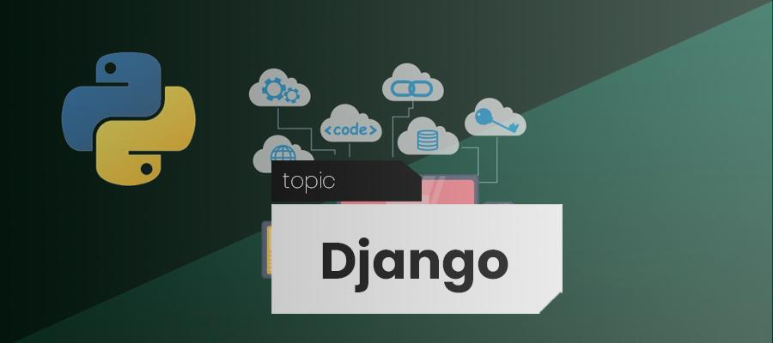
Introduction

Slide 4
Why Django
With Django, you can take web applications from concept to launch in a matter of hours.
Django takes care of much of the hassle of web development, so you can focus on writing your app without needing to reinvent the wheel.
It’s free and open source.

Slide 5
Why Django
Django is easy to learn, yet powerful and flexible enough to grow with your needs.
Ridiculously fast.
Fully loaded.
Reassuringly secure.
Exceedingly scalable.
Notes:
Giảng viên giới thiệu và chạy một số ứng dụng web để học viên hình dung

Slide 6
Scaffolding a Django Project
and App

Slide 7
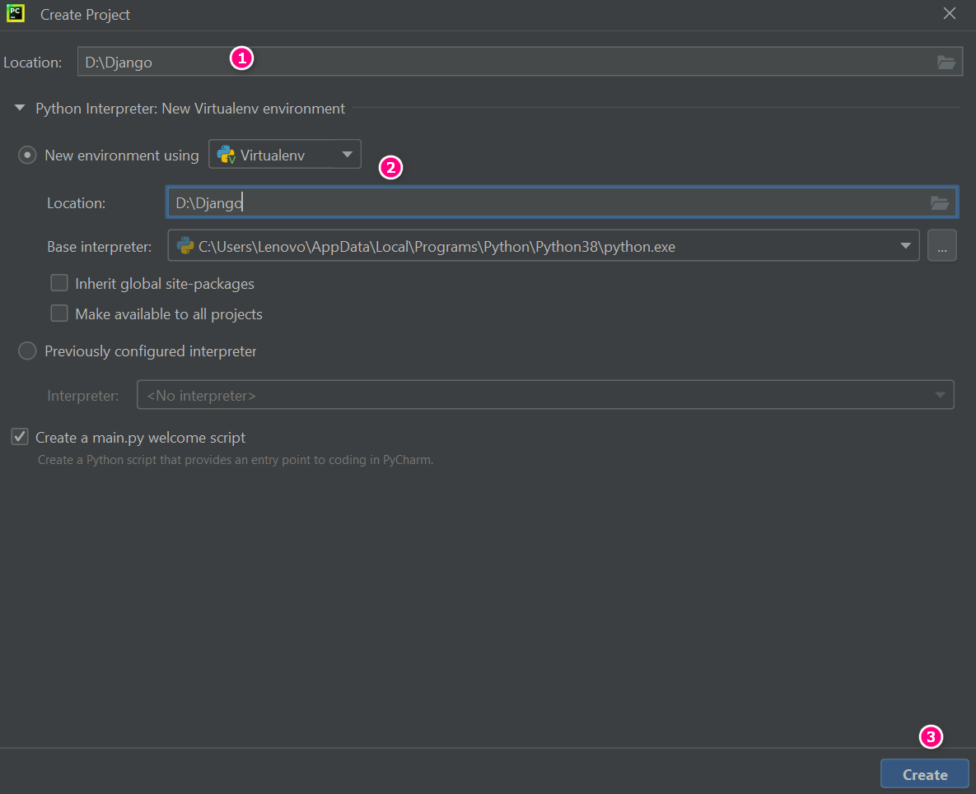
Create new project

Slide 8
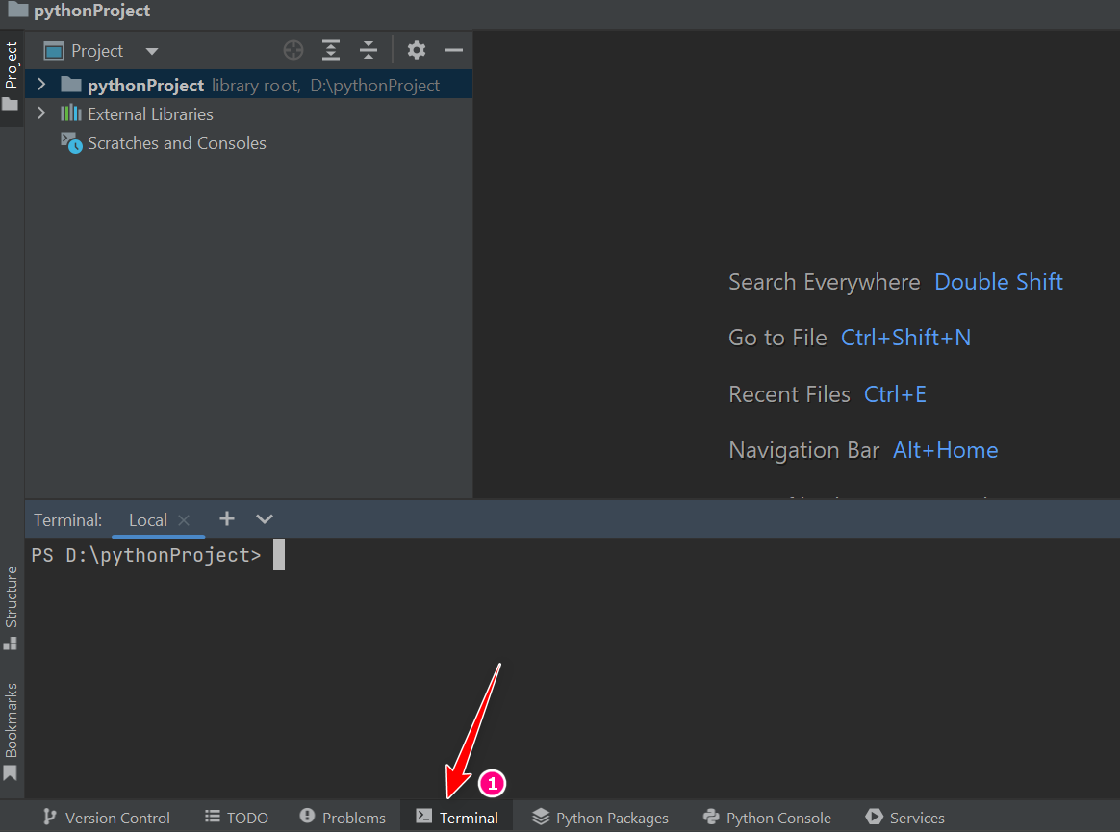
Terminal command
Position will use to write commands to create projects, create applications.

Slide 9
Virtualenv
Using a Python virtual environment, which will keep the Python packages for Web Development with Django separate from your system packages.

Slide 10
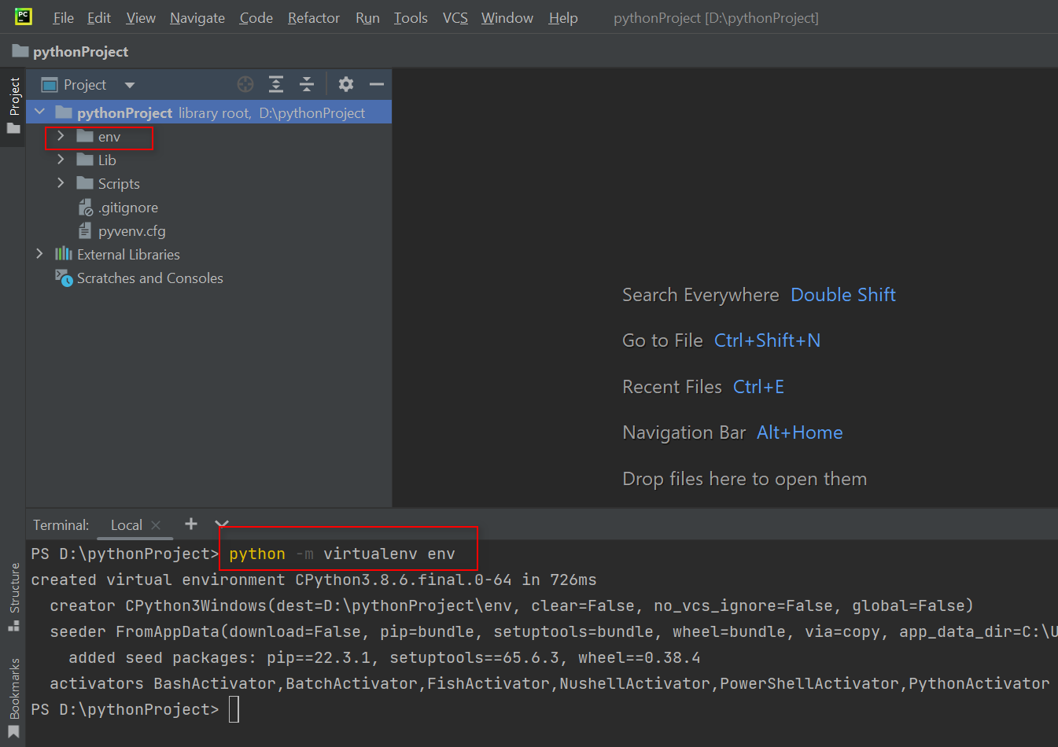
Create a virtual environment
python3 -m virtualenv <virtualenvname>

Slide 11
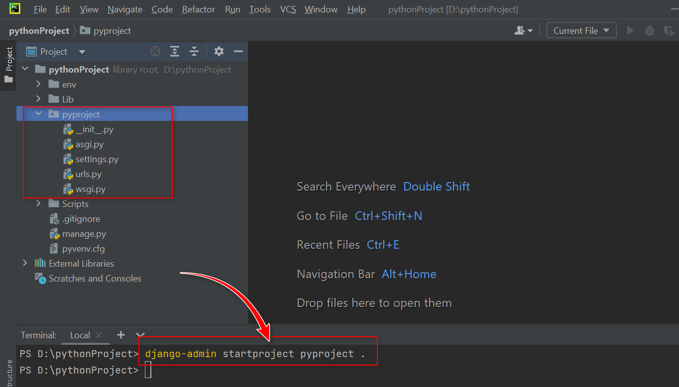
Create a Django Project
To create a Django project with the name pyproject, the command that is run is this
django-admin startproject <projectname> .

Slide 12
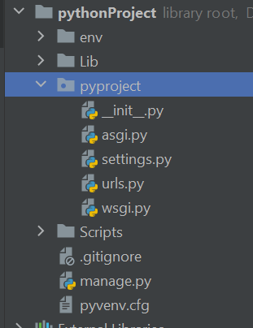
Create a Django
manage.py is a Python script that is executed at the command line to interact with your project.

Slide 13
Starts the Django dev server.
This passes the runserver command to the manage.py script, which starts the Django dev server.
Command
python3 manage.py runserver

Slide 14
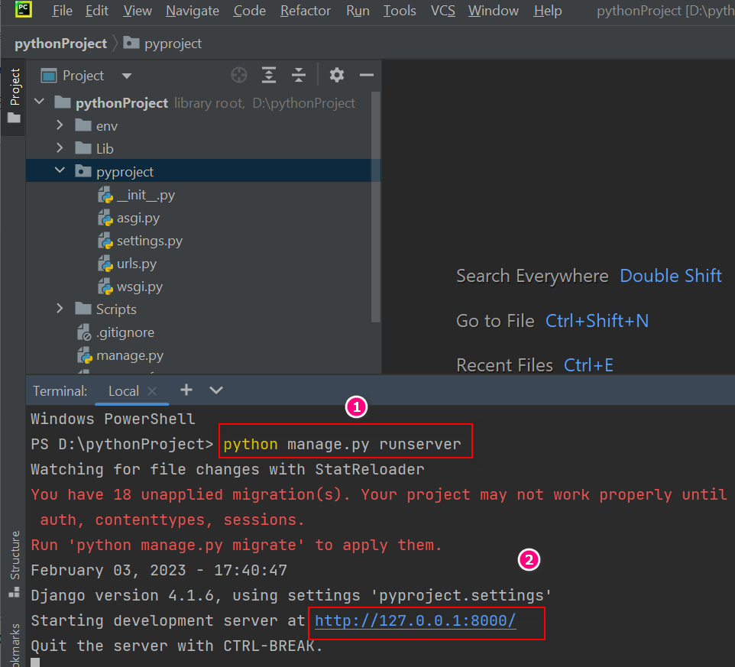
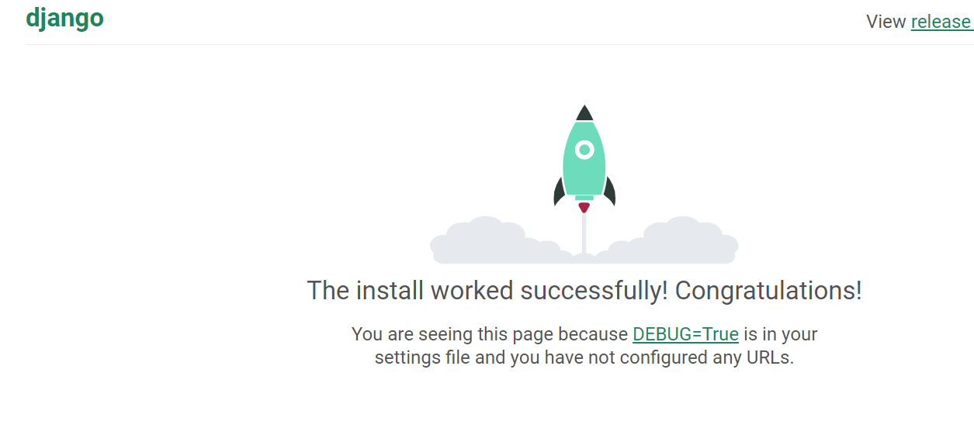
Run server

Slide 15
Start a Django app
After starting the Django project, the next thing to do is to start a Django app. We should try to segregate our Django project into different apps, grouped by functionality
Command
python manage.py startapp <appname>

Slide 16
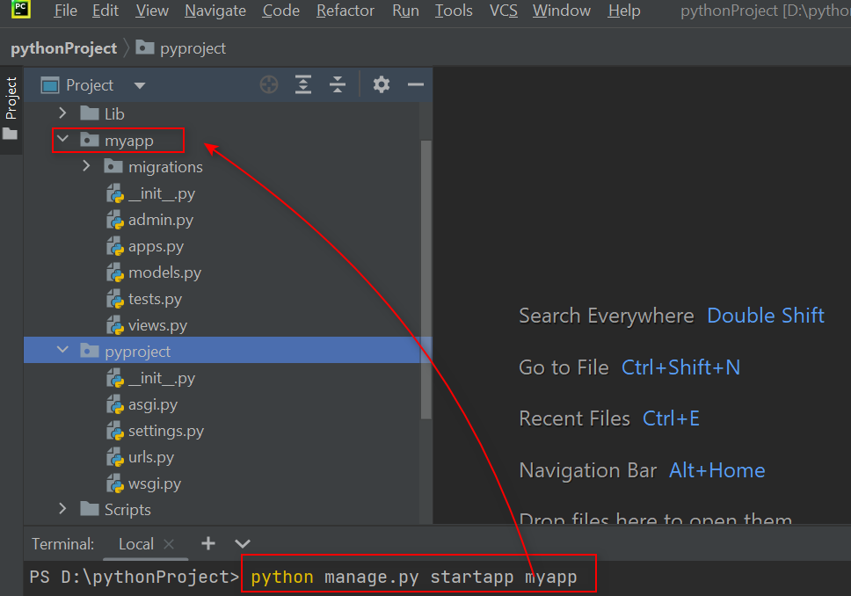
Start a Django app

Slide 17
Model View Template

Slide 18
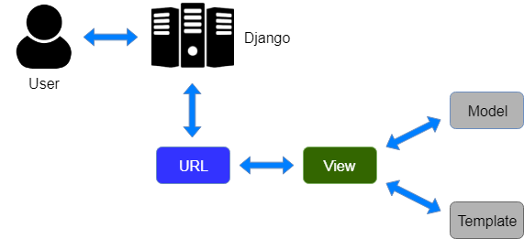
Model View Template

Slide 19
Models
Django models define the data for your application and provide an abstraction layer to SQL database access through an Object Relational Mapper (ORM).
An ORM lets you define your data schema (classes, fields, and their relationships) using Python code, without needing an understanding of the underlying database.

Slide 20
Views
A view is a function that you write that will receive this request in the form of a Python object (specifically, a Django HttpRequest object).
Your view must return an HttpResponse object that encapsulates all the information being provided to the client: content, HTTP status, and other headers.

Slide 21
Templates
A template is a HyperText Markup Language (HTML) file (usually – any text file can be a template) that contains special placeholders that are replaced by variables your application provides.

Slide 22
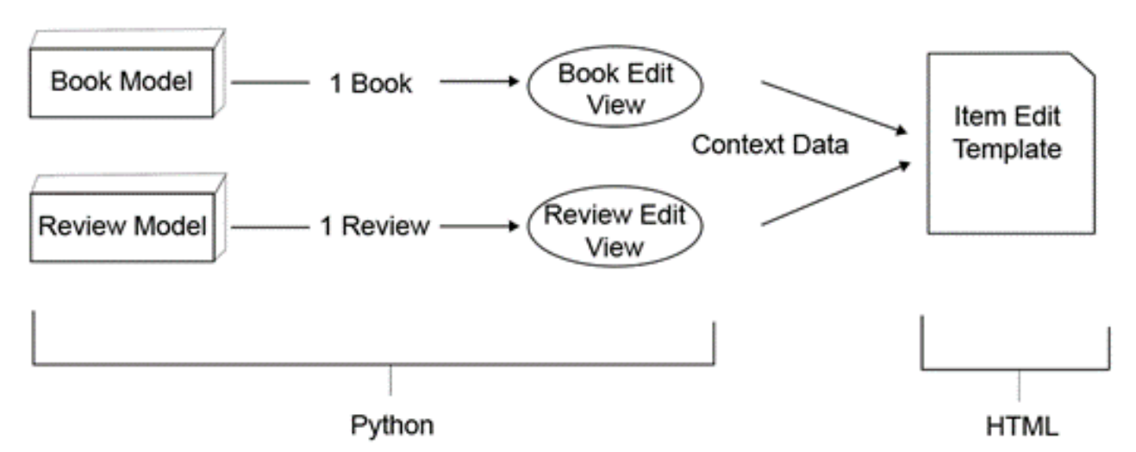
MVT in Practice
\
Editing a single book or review

Slide 23
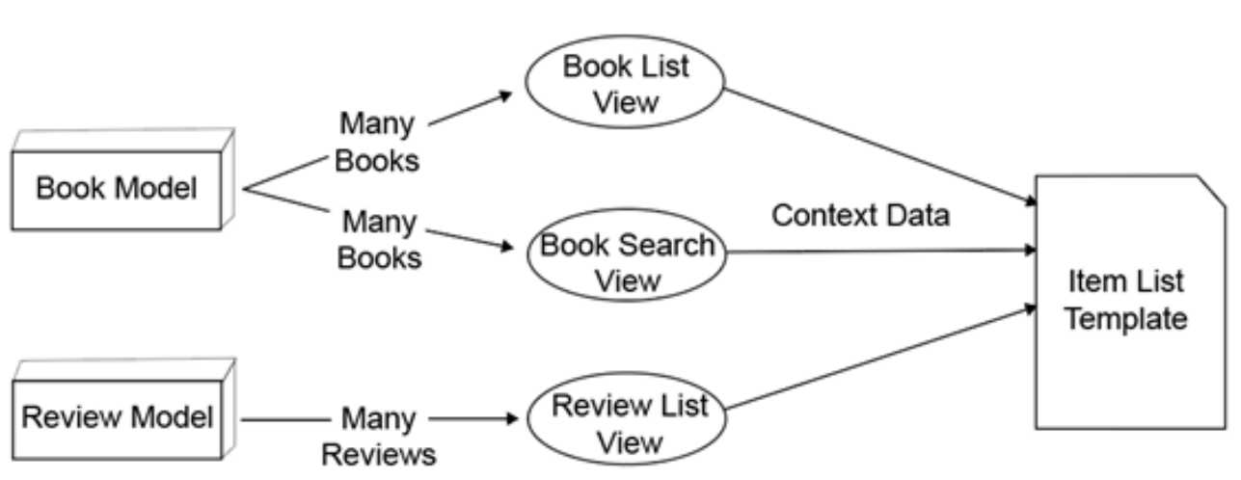
MVT in Practice
Viewing multiple books or reviews

Slide 24
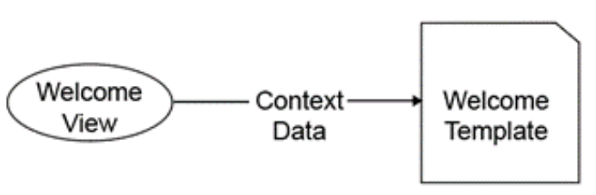
MVT in Practice
From view to template without a model

Slide 25
Introduction to HTTP

Slide 26
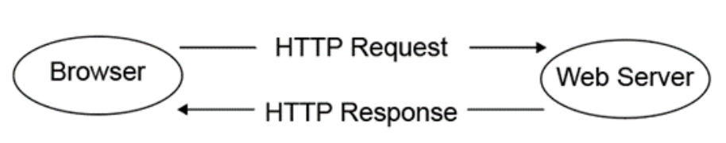
HTTP request and HTTP response
Once a web server receives the HTTP request from your browser, it can interpret it and then send back a response

Slide 27
HTTP request and HTTP response
Host: As mentioned, this is the only header that is required (for HTTP 1.1 or later).
User-Agent: Your browser usually sends to the server a string identifying its version and operating system.
Cookie: You have probably seen a message when visiting a web page that lets you know that it is storing a cookie in the browser

Slide 28
HTTP request and HTTP response
Content-Type : This tells the server the type of data that is included in the body. In the case of application/x-www-form-urlencoded, the body is a set of key-value pairs.
Content-Length: For the server to know how much data to read, the client must tell it how much data is being sent.

Slide 29
HTTP request and HTTP response
Server: This is similar to but the opposite of the User-Agent header: this is the server telling the client what software it is running.
Content-Length: The client uses this value to determine how much data to read from the server to get the body.

Slide 30
HTTP request and HTTP response
Content-Type: The server uses this header to indicate to the client what type of data it is sending
Set-Cookie: We saw in the first request example how a client sends a cookie to the server..

Slide 31
HTTP request and HTTP response
100-199: The server sends codes in this range to indicate protocol changes or that more data is required. You don't have to worry about these.
200-299: A status code in this range indicates the successful handling of a response. The most common one you will deal with is 200 OK.

Slide 32
HTTP request and HTTP response
300-399: A status code in this range means the page you are requesting has moved to another address.
400-499: A status code in this range means that the request could not be handled because there was a problem with what the client sent.

Slide 33
HTTP request and HTTP response
500-599: Status codes in this range indicate an error on the server's side. The client shouldn't expect to be able to adjust the request to fix the problem.

Slide 34
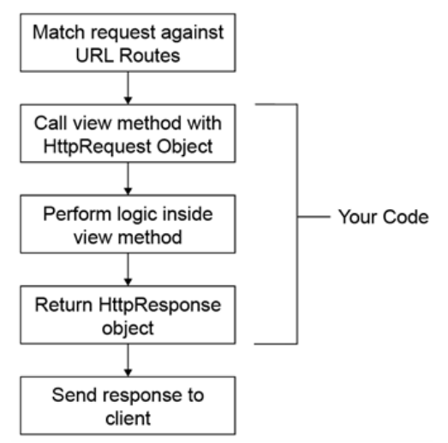
Processing a Request
Request and response flow

Slide 35
Django Project

Slide 36
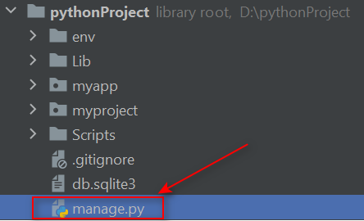
manage.py
Most of the commands that are used to interact with your project will be supplied to this script on the command line. The commands are supplied as an argument to this script;

Slide 37
manage.py
runserver: Starts the Django development HTTP server, to serve your Django app on your local computer.
startapp: Creates a new Django app in your project. We'll talk about what apps are in more depth soon.
shell: Starts a Python interpreter with the Django settings pre-loaded.

Slide 38
manage.py
dbshell: Starts an interactive shell connected to your database, using the default parameters from your Django settings.
makemigrations: Generate database change instructions from your model definitions.
migrate: Applies migrations generated by the makemigrations command
Notes:
Kết thúc slide này cho học viên làm Ex1.01

Slide 39
The project Directory

Slide 40
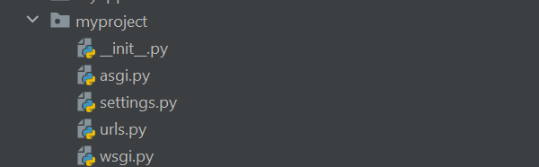
The project Directory
The project package
(inside the pyproject project directory)

Slide 41
The project Directory
__init__.py
An empty file that lets Python know that the myproject directory is a Python module. You'll be familiar with these files if you've worked with Python before.

Slide 42
The project Directory
settings.py
This contains all the Django settings for your application. We will explain the contents soon.

Slide 43
The project Directory
urls.py
This has the global URL mappings that Django will initially use to locate views or other child URL mappings. You will add a URL map to this file soon.

Slide 44
The project Directory
asgi.py and wsgi.py
These files are what ASGI or WSGI web servers use to communicate with your Django app when you deploy it to a production web server.

Slide 45

Django Development Server
By default, the server listens on port 8000 on localhost (127.0.0.1)

Slide 46

Django Development Server
This will have the server listen on port 8001 on localhost (127.0.0.1).
You can also have it listen on a specific address if your computer has more than one, or 0.0.0.0 for all addresses:
Notes:
Kết thúc slide này cho học viên làm Ex1.02

Slide 47
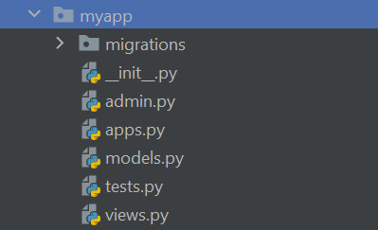
Django Apps

Slide 48
Django Apps
__init.py__: An empty file indicating that this directory is a Python module.
admin.py: Django has a built-in admin site for viewing and editing data with a Graphical User Interface (GUI).
apps.py: This contains some configuration for the metadata of your app. You won't need to edit this file.

Slide 49
Django Apps
models.py: This is where you will define the models for your application.
migrations: Django uses migration files to automatically record changes to your underlying database as the models change.

Slide 50
Django Apps
tests.py: To test that your code is behaving correctly, Django supports writing tests (unit, functional, or integration) and will look for them inside this file.
views.py: Your Django views (the code that responds to HTTP requests) will go in here.

Slide 51
View Details
POST: Another QueryDict containing the parameters sent to the view in a POST request, like from a form submission.
headers: A case-insensitive key dictionary with the HTTP headers from the request.
path: This is the path used in the request.

Slide 52
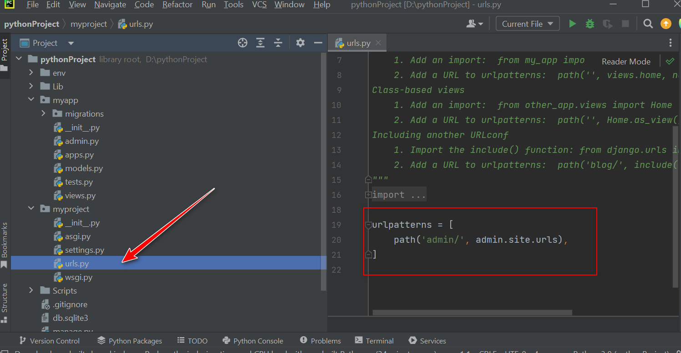
URL Mapping Detail
The URL-to-view mapping is defined in the file that Django automatically created called urls.py

Slide 53
URL Mapping Detail
urlpatterns, which is a list of paths that Django evaluates in turn until it finds a match for the URL being requested.
Django calls it with an HttpRequest instance and any parameters parsed from the URL.
Notes:
Kết thúc slide này cho học viên làm bài tập 1.03

Slide 54
GET, POST, and QueryDict Objects
Django automatically parses these parameter strings into QueryDict objects.
QueryDict objects are objects that mostly behave like dictionaries, except that they can contain multiple values for a key.

Slide 55

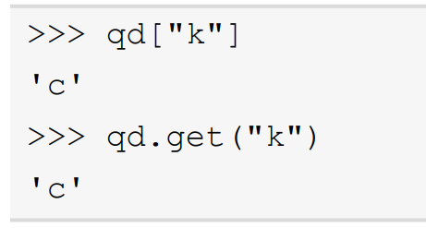
GET, POST, and QueryDict Objects
First, the QueryDict qd is constructed from a parameter string:
When accessing items with square bracket notation or the get method

Slide 56


GET, POST, and QueryDict Objects
To access all the values for a key, the getlist method should be used:
getlist will always return a list—it will be empty if the key does not exist.

Slide 57
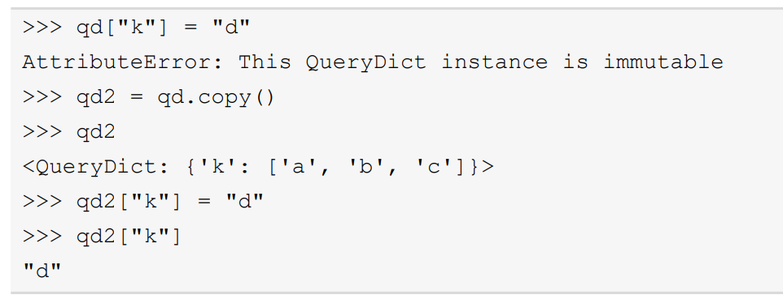
GET, POST, and QueryDict Objects
The QueryDict objects for GET and POST are immutable (they cannot be changed), so the copy method should be used to get a mutable copy if you need to change its values:

Slide 58
GET, POST, and QueryDict Objects
To give an example of how QueryDict is populated from a URL, imagine an example URL: http://127.0.0.1:8000?val1=a&val2=b&val2=c&val3

Slide 59


GET, POST, and QueryDict Objects
Access the parameters inside the view function as follows:
Using standard dictionary access, it would return the value a.

Slide 60


GET, POST, and QueryDict Objects
Using standard dictionary access, there are two values set for the val2 key, so it would return the last value, c:
This would return a list of all the values for val2: ["b", "c"]:

Slide 61


GET, POST, and QueryDict Objects
This key is in the query string but has no value set, so this returns an empty string.
This key is not set, so KeyError will be raised. Use request.GET.get("val4") instead, which will return None:

Slide 62
Exploring Django Settings

Slide 63
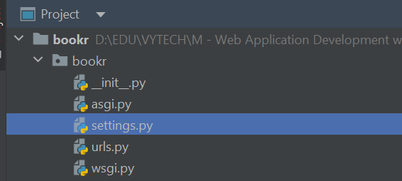
settings.py
This file contains many settings that can be used to customize Django. A default settings. py file was created for you when you started the project.

Slide 64

settings.py
This is the Python module that Django will load first to find URLs. Note that it is the file we added our index view URL map to previously.

Slide 65
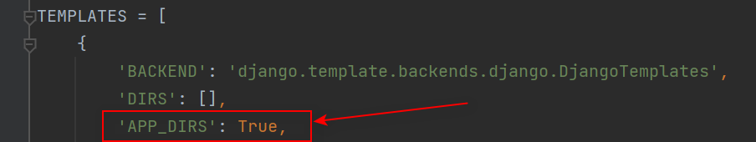
settings.py
This tells Django it should look in a templates directory inside each INSTALLED_ APP when loading a template to render. We don't have a templates directory for reviews yet.
Notes:
Exercise 1.05: Creating a Templates Directory and a Base Template

Slide 66
Rendering Variables in Templates
Templates aren't just static HTML. Most of the time, they will contain variables that are interpolated as part of the rendering process.
Inside a template, variables are denoted by double braces, {{ }}
To render a variable in a template, simply wrap it with braces: {{ book_name }}.

Slide 67
Summary
HTTP protocol and the structure of HTTP requests and responses
Django uses the MVT paradigm, and then how it parses a URL, generates an HTTP request, and sends it to a view to get an HTTP response
Built two example views to illustrate how to get data from a request and use it when rendering templates

